Slide 1
Components

Slide 2
Components
Components are the building blocks of any React app and a typical React app will have many of these.
A component is a JavaScript class or function that optionally accepts inputs i.e. properties(props) and returns a React element that describes how a section of the UI (User Interface) should appear.

Slide 3
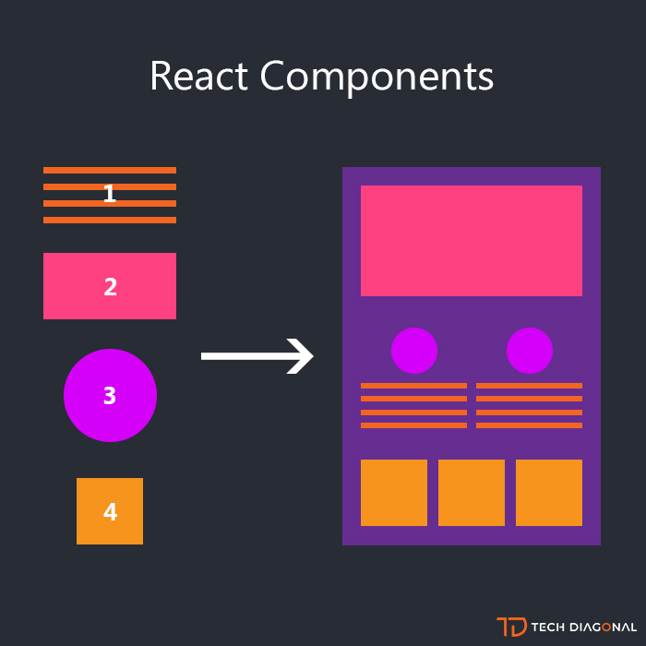
Component Daigram

Slide 4
Types of components
Functional Components
Class Components

Slide 5
Functional Components
Functional components are simply javascript functions. We can create a functional component in React by writing a javascript function. These functions may or may not receive data as parameters
const Democomponent=()=>
{
return <h1>Welcome Message!</h1>;
}

Slide 6
Class Components
The class components are a little more complex than the functional components. We can pass data from one class component to other class components. We can use JavaScript ES6 classes to create class-based components in React.
class Democomponent extends React.Component
{
render(){
return <h1>Welcome Message!</h1>;
}
}

Slide 7
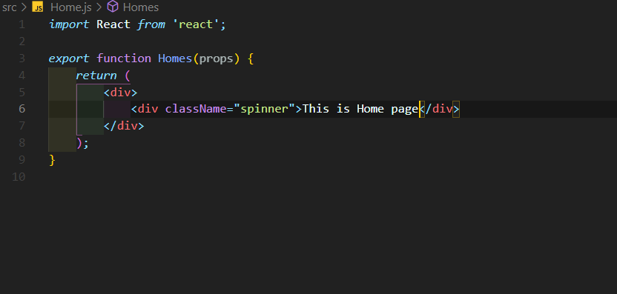
Functional Component

Slide 8
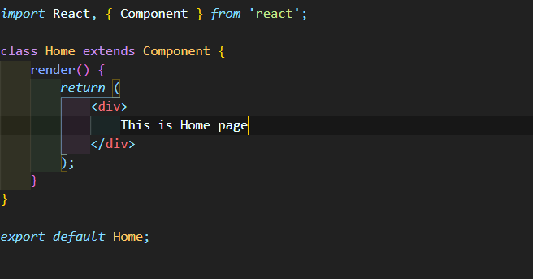
Class component

Slide 9
Stateful and stateless component
A stateless component is usually associated with how a concept is presented to the user. It is similar to a function in that, it takes an input (props) and returns the output (react element).
A stateful component is dependent on it’s state object and can change it’s own state. The component re-renders based on changes to it’s state, and may pass down properties of it’s state to child components as properties on a props object.

Slide 10
When would you use a stateless component?
When you just need to present the props
When you don’t need a state, or any internal variables
When creating element does not need to be interactive
When you want reusable code

Slide 11
When would you use a stateful component?
When building element that accepts user input
..or element that is interactive on page
When dependent on state for rendering, such as, fetching data before rendering
When dependent on any data that cannot be passed down as props

Slide 12
Statefull component
//a React component declaration
class ExampleComponent extends React.Component {
constructor(props){
super(props);
// the local state of the component
this.state = {
//components properties
location: 'local state',
}
}
// render properties from the state
render(){
return
<div>This content is from the {this.state.location}!</div>
}
}

Slide 13
Stateless Component
//a React stateless functional component
const ExampleComponent = (props) => {
const alertLocation = (event) => {
alert(`This content is from ${location}`);
}
// when the component is instantiated send the div to the html document
return(
<div><a href="#" onClick={alertLocation}>Location?</a></div>;
)
}

